Slide 1


DEPARTMENT OF AUTOMOBILE ENGINEERING
MIT CAMPUS, ANNA UNIVERSITY, CHENNAI – 44
FIRST REVIEW
S.No | Name | Register Number
1 | NIROSHINI. K | 2019502032
2 | AKILAN. S | 2019502509
3 | DHINESH BABU. R | 2019502517
4 | HARI VIGNESH. N S | 2019502523
GUIDE:
Mr. P.Elayaraja
Teaching Fellow,
Department of Automobile Engineering,
MIT campus, Anna university

Slide 2
TITLE
EXPERIMENTAL ANALYSIS OF PERFORMANCE,COMBUSTION AND EMISSION CHARACTERISTICS OF SINGLE CYLINDER DIESEL ENGINE USING BIODIESEL (DIESEL-TURPENTINE BLEND) WITH HYDROGEN INDUCTION.

Slide 3
INTRODUCTION
Entire worldwide, fossil reserves are getting scantier and progressively exorbitant with time.
Moreover, constant dependency on them leads to the frightening plight of global warming. Higher fuel prices and limited natural resources have forced the researchers to pursue research on green alternative fuels.
The use of biodiesel obtained from plants in internal combustion engine is finding its place to replace the use of conventional fuel. In our research, the performance, combustion and emission characteristics of diesel engine fueled with biodiesel (diesel-turpentine blend) with hydrogen induction.

Slide 4
LITERATURE SURVEY
si no | journal name | year | author | topic | inference
1 | Elsevier | 2020 | Freedon Daniel, Kannan Muthu, Dhanusiya Balamurugan, Balamurugan Adhithan, Elavarasan Govindaraj | Experimental investigation of a diesel engine operated with oxygenated linseed oil | In this study cold pressed linseed oil was used to produce linseed biodiesel by using transesterification method was blended along with petroleum diesel to obtain LS5 (5% Linseed Biodiesel, 95% diesel), LS10 (10% Linseed Biodiesel, 90% diesel) and LS15 (15% Linseed Biodiesel, 85% diesel). co , Hc, Nox emissions was reduced .
2 | Elsevier | 2018 | Danilo Leitea, Reginaldo Ferreira Santosa, Doglas Bassegioa, Samuel Nelson Melegari de Souzaa,Deonir Seccoa, Flavio Gurgacza, Tiago Roque Benetoli da Silvab | Emissions and performance of a diesel engine affected by soybean, linseed, and crambe biodiesel | The objective of the work was to assess the performance and emissions of a diesel engine for energy generation that operated with soybean, linseed, and crambe vegetal-oil-based fuels.Linseed biodiesel resulted in a linear increase of power.

Slide 5
3 | Elsevier | 2020 | Sudalaiyandi K a, Karthick Alagar b, Vignesh Kumar R a, Manoj Praveen VJ a, Madhu P c | Performance and emission characteristics of diesel engine fueled with ternary blends of linseed and rubber seed oil biodiesel | Five ternary blends have been prepared in a variety of proportions from linseed and rubber seed oil. Ternary blends are lower in NO2 and CO emissions than base diesel. Blends 1 and 2 have an almost equal calorific value compared to diesel. The CO and NO2 emissions of these blends are lower compared to diesel.
4 | Elsevier | 2022 | Anil singh yadhav, rahul sahu, Abishek sharma, P. Thangamuthu | Potential utilization of turpentine oil as an alternative fuel | This paper discusses about the production methods of turpentine oil, its important physicochemical properties and application as diesel engine fuel.
5 | Elsevier | 2018 | Pankaj Dubey , Rajesh Gupta | Influences of dual bio-fuel (Jatropha biodiesel and turpentine oil) on single cylinder variable compression ratio diesel engine | At full load and compression ratio 20 of the dual bio-fuel, there was 2.17% increase in brake thermal efficiency and 13.04%, 17.5%, 4.21% and 30.8% decrease in CO, HC and NOx and smoke opacity respectively while CO2 was observed to increase by 11.04% respectively

Slide 6
6 | Elsevier | 2010 | B. Prem Anand, C.G. Saravanan, C. Ananda Srinivasan | Performance and exhaust emission of turpentine oil powered direct injection diesel engine | The results showed that the addition of 30% TPOF with DF produced higher brake power and net heat release rate with a net reduction in exhaust emissions such as CO, HC, NOx, smoke and particulate matter.
7 | researchgate | 2017 | Mehmet Hakkı Alma, Tufan Salan | A review on novel bio-fuel from turbentine oil | At 40% turbentine oil mixture,2.5% increase in BTE than the diesel.nearly 50% smoke was reduced but a little shoot and co eas found
8 | Elsevier | 2020 | Ahmet Uyumaz | Experimental evaluation of linseed oil biodiesel/diesel fuel blends on combustion, performance and emission characteristics in a DI diesel engine | This paper focuses on the influences of linseed oil biodiesel-diesel fuel blends in view of combustion, engine performance and emission characteristics at various engine loads in a DI diesel engine

Slide 7
9. | International journal of advance Engineering | 2019 | T.Thirumalai, M.Prakashbabu, A. Harsha Varthan Reddy, M.Ramalinga Reddy, A.Raj Kumar | Performance of Biodiesel Fuel and Neem Oil Blends in Single Cylinder Diesel Engine | In this paper it concludes that the emission of CO,CO2,HC were reduced for the esterified neem oil.
10. | springer | 2018 | V. karthickeyan | Experimental analysis on thermally coated diesel engine with neem oil methyl ester and its blends | In this paper it shows that, 50%of neem with methyl ester show less BTE,25NOME show less BSFC,it reduce the CO ,Hc emission for 25NOME, and NOX was increased for both the blends 25 and 50%.
11. | SAE | 2010 | Avinash kumar Agarwal1 , Deepak Agarwal2 | Novel Methodology to Utilise Neem (Azadirachta Indica) Oil in a Direct Injection Compression Ignition Engine: Performance and Emissions Characterization | BSFC and exhaust gas temperatures for unheated Neem oil were found to be higher compared to diesel and preheated Neem oil. Thermal efficiency was slightly lower for unheated Neem oil compared to preheated Neem oil and diesel. CO2, CO, HC, and smoke opacity were higher for Neem oil compared to diesel.

Slide 8
12. | Elsevier | 2017 | B.Ashok , R. Thundil Karuppa,K.Nanthagopal , Rahul Krishnan , Jayapati Subbarao | Lemon peel oil - A novel renewable alternative energy source for diesel engine | lower cetane index & lemon peel influences the ignition delay period & peak heat release rate that lead to penalty in Nox
13. | Elesvier | 2017 | A.Naresh kumar, Dr. M Brahma Raju , Dr. P. Srinivas Kishore , K. Narayana | some Experiment studies on effect on exhaust-gas recirculation on performance & emission characteristics of a compression ignition engine fuelled with diesel & lemon peel oil blends | Engine performance characteristics have been improved with high proportion of lemon peel oil. In this research 20% of LPME carbon monoxide of hydro-carbon emission are reduced . improvement in BPFC &nBTE . Nox will be reduced by EGR

Slide 9
RESEARCH GAP
Turpentine oil is an effective alternate biofuel for diesel because it has
very common characteristics with diesel .
Turpentine oil blend with diesel results shows slight increase in performance and emission characterictics .
with Hydrogen induction method normally a diesel engine shows a very good performance. So using this method for turpentine oil diesel blend we expect more increase in performance and emission characteristics

Slide 10
AIM & OBJECTIVE
To experimentally test the performance , combustion , emissions characteristics of single cylinder diesel engine using biodiesel.
Objective is to compare the characteristics of biodiesel blends(diesel-turpentine) and the same with hydrogen induction.

Slide 11
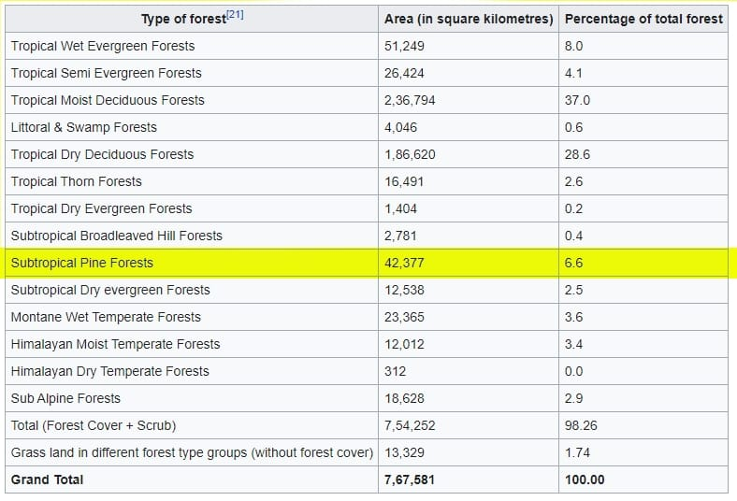
PINE TREE GROWTH IN INDIA

Slide 12
METHODLOGY
Literature survey
Problem identification
Preparation of biodiesel blend
Measuring the properties of the sample biodiesel blend
Testing of the sample biodiesel in CI engine
Comparison of characteristics(biodiesel blends vs diesel)

Slide 13
METHODLOGY
Installation of experimantal setup for hydrogen induction
Testing of the sample biodiesel blend with hydrogen induction
Calculation of the characteristics obtained from the result
Comparison of characteristics (biodiesel blend vs diesel)
submission of final report

Slide 14
PROPERTIES OF FUEL
S.NO | PROPERTIES | DIESEL | TURPENTINE | HYDROGEN
1 | Normal state | Liquid | Liquid | Gaseous
2 | Formula | C₁₀H₂₂ | C₁₀H₁₆ | H₂
3 | Density (kg/m3) | 833-881 | 860-900 | 0.08
4 | Specific gravity | 0.83 | 0.86-0.9 | 0.07
5 | Flash point(°C) | 74 | 38 | –
6 | Autoignition temperature (°C) | 250 | 300-350 | 572
7 | Boiling point(°C) | 180-340 | 150-180 | -252.8
8 | Flammability limit% volume | 1 | 0.8 | 4
9 | Cetane number | 40 - 55 | 20-25 | -

Slide 15
ENGINE SPECIFICATION
S.NO | PARAMETERS | SPECIFICATIONS
1. | General details | Single cylinder, four stroke, compression ignition, constant speed,vertical, water cooled, direct injection
2. | Bore length | 80mm
3. | Stroke length | 110mm
4. | Swept volume | 553cc
5. | Clearance volume | 36.87cc
6. | Compression ratio | 16.5:1
7. | Rated output | 3.7 kW at 1500 rpm
8. | Rated speed | 2000 rpm
9. | Injection pressure | 240bar

Slide 16
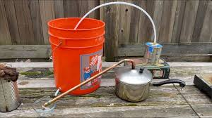
EXTRACTION OF TURPENTINE
Collection of pine saps
Heating of pine saps to a viscous liquid stage
filtration of the large impurities
Collection of turpentine oil
Distillation of the heated pine sap liquid
Again heat the viscous pine sap liquid

Slide 17
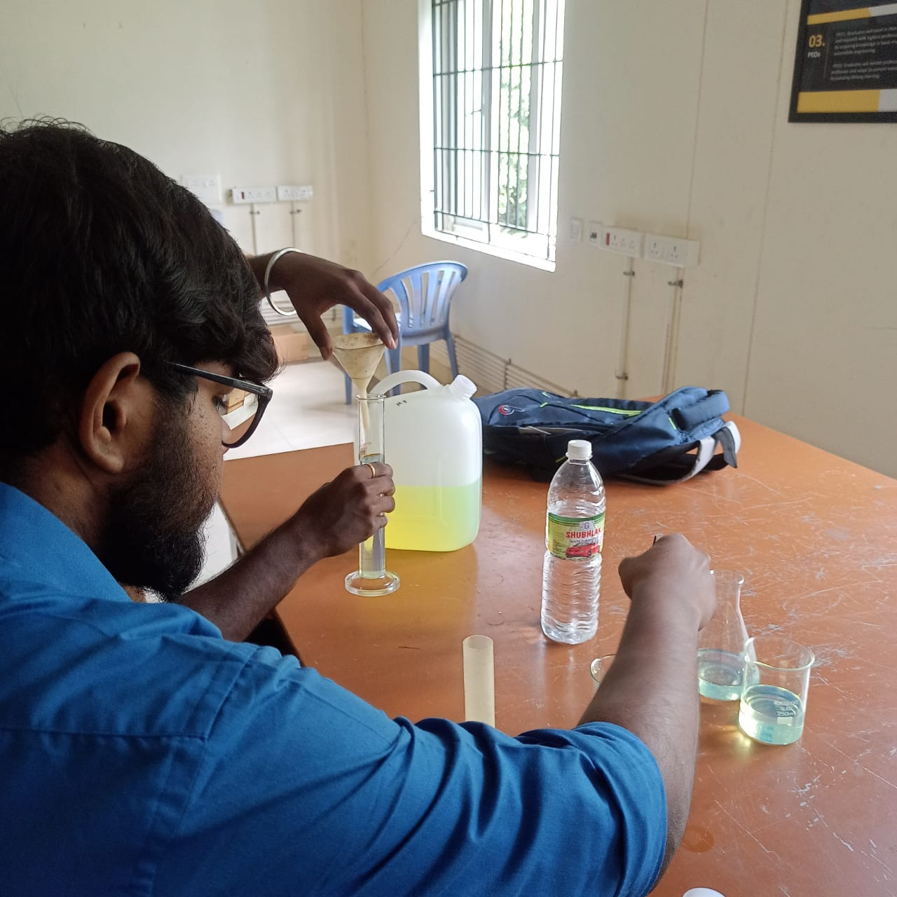
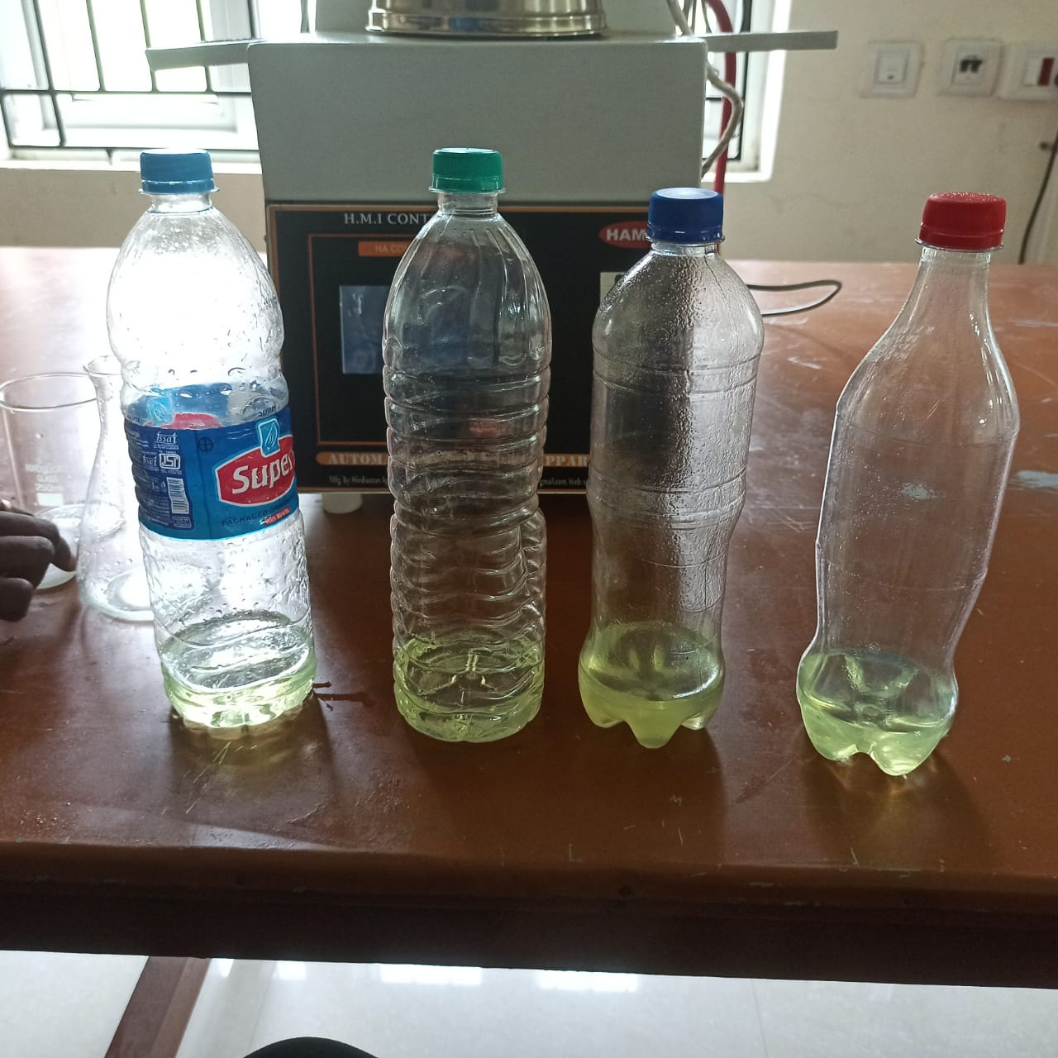
PREPATION OF BIODIESEL(DIESEL-TURPENTINE BLEND)
4 BLENDS:
B20
B30
B40
B50

Slide 18
CURRENT STATUS
literature survey completed
work process plan and methodology completed
Preparation of biodiesel blend is completed.

Slide 19
WORK TO BE DONE
Finding the properties of biodiesel blends
Testing of biodiesel in ci engine
Comparison of characteristics of diesel with biodiesel
Experimental setup for hydrogen induction in single cylinder diesel engine.
Testing of biodiesel with hydrogen induction
Comparison of characteristics of biodiesel blend and the same with hydrogen induction.
Submission of report.

Slide 20
Thank you

